Slide 1
Lecture11 Construction, Final Verification and Validation, and Closeout Phase
Reading: Main text, Chp13; Sup text, Chp 10
Lek Hsiang Hui

Slide 2
Outline
Construction Phase
Final Verification and Validation Phase
Closeout Phase
Planning and Managing

Slide 3

Phases
We can generalize SDLC into 5 different phases:
Initiation
Discovery
Construction
Final Verification and Validation
Closeout

Slide 4
Phases
We can generalize SDLC into 5 different phases:
Initiation
Discovery
Construction
Final Verification and Validation
Closeout

Slide 5
Construction Phase
Construction Phase
Final Verification and Validation Phase
Closeout Phase
Software Design Patterns

Slide 6

Recall: Construction
Includes Design, Implementation and Testing discipline

Slide 7

Design and Coding
Design (UI) and Coding take place

Slide 8

Construction Phase
Business analysis activity during this phase depends on the lifecycle approach being used:
Waterfall projects (predictive)
Iterative projects (adaptive)

Slide 9
Waterfall Projects
IT BA’s job now is to support quality assurance and validate technical design meets the requirements
Project Planning Phase
Analysis Phase
Design Phase
Implementation Phase
Support Phase
Planning Specifications frozen
Analysis Specifications frozen
No requirements analysis in this phase
Design Specifications frozen
Finished system delivered
exactly as specified
Notes:
9

Slide 10
Construction Phase
In iterative projects
Requirements analysis and solution development take place over a number of iterations
The steps described for the Discovery phase are carried out during each iteration of the Construction phase

Slide 11
Iterative Projects
Some Analysis
Some Design
Some Implementation
More Analysis
More Design
More Implementation
Even More Analysis
Even More Design
Even More Implementation
IS2102 Requirements Analysis and Design
Notes:
11

Slide 12
Implementation

Slide 13
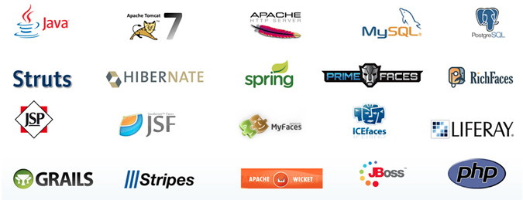
Frameworks and common standards
Recommended to use frameworks and common standards for development
Ensure interoperability
Ensure standardization and better integration with other system (or future systems)
Speeds up development process

Slide 14
Software Design patterns
Construction Phase
Final Verification and Validation Phase
Closeout Phase
Software Design Patterns

Slide 15
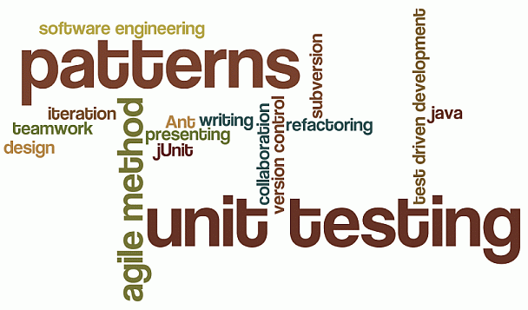
Software design Patterns
Often we find that many software systems have similar architectural structures, design patterns are approaches to design the architecture

Slide 16

Elements of a Pattern
4 elements of a pattern:
Name
Problem
Solution
Constraints
Notes:
Name of pattern
Problem describes when to apply the pattern (what problem it solves)
Solutions describes how to solve the problem
Constraints are the results and trade-offs of apply the pattern

Slide 17

Why study design patterns?
These design patterns are best practices which considers various factors. Some of them are natural solution to a problem

Slide 18
Structural patterns

Slide 19
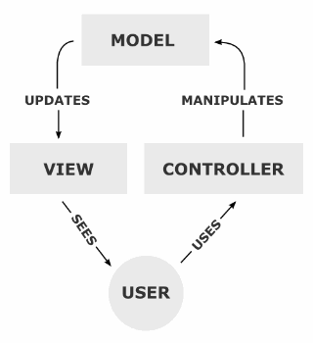
Model/View/Controller (MVC)
Model : Domain object (updates the view)
View : Presentation
Controller : receives commands from user and invoke the model’s methods (direct traffic)
One of the most popular design pattern nowadays, commonly used for web applications

Slide 20
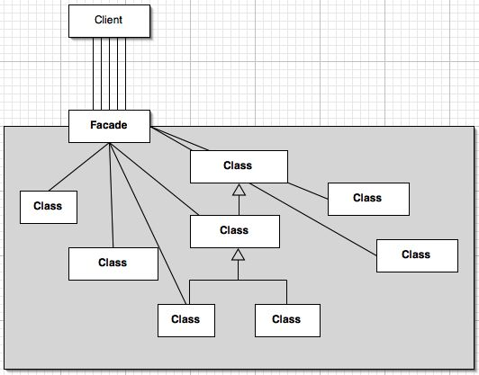
Facade
Provides a unified interface to a set of interfaces in a subsystem
Idea is to wrap a complex subsystem with a simplified interface
Notes:
http://www.javaworld.com/javaworld/jw-05-2003/jw-0530-designpatterns.html

Slide 21
Adaptor (Wrapper)
Idea is to convert the interface of a class into another interface that the client expects (Wrapper)
An adaptor allows classes to work together that normally could not due to incompatible interfaces
Notes:
http://patternko.com/adapter-pattern-design/
http://www.oodesign.com/adapter-pattern.html

Slide 22
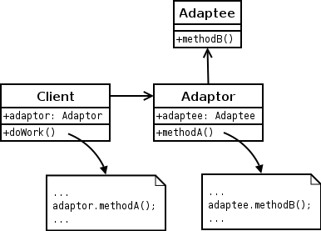
Adaptor (Wrapper)
Notes:
http://patternko.com/adapter-pattern-design/
http://www.oodesign.com/adapter-pattern.html
http://en.wikipedia.org/wiki/Adapter_pattern

Slide 23
Creational Patterns

Slide 24
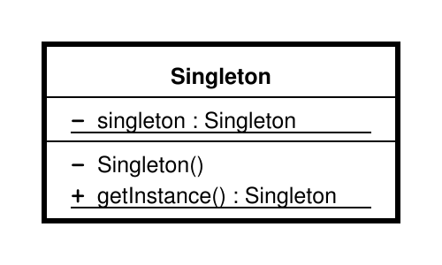
Singleton
Restrict the instantiation of a class to one object
Commonly used for the Data Access layer (e.g. EntityManager in JavaEE)
Notes:
http://www.codeproject.com/Articles/386926/Singleton-Refactoring

Slide 25
Factory
Make use of a Factory class to create objects
interface ConnectionFactory{
public Connection createConnection();
}
class MyConnectionFactory implements ConnectionFactory{
public Connection createConnection(){
…
return connection;
}
}
//main method:
ConnectionFactory factory = new MyConnectionFactory();
Connection conn = factory.createConnection();
Notes:
http://en.wikipedia.org/wiki/Observer_pattern

Slide 26
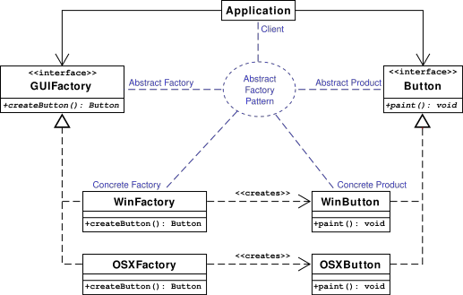
Abstract Factory
A more general version of Factory design pattern (can have multiple Factory)
Uses a concrete implementation of the the abstract factory to create concrete objects
Notes:
http://en.wikipedia.org/wiki/Observer_pattern

Slide 27
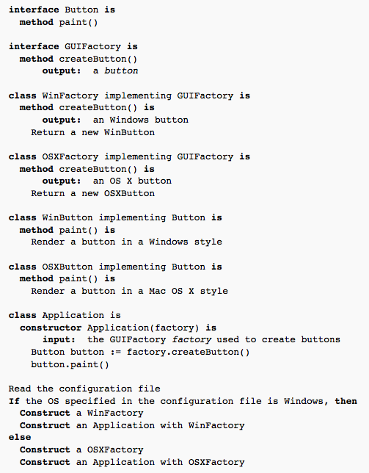
Abstract Factory
Notes:
http://en.wikipedia.org/wiki/Observer_pattern

Slide 28
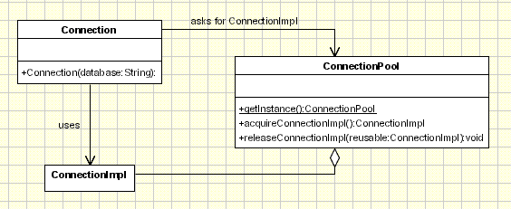
Object Pool
Idea: want to reuse and share objects that are expensive to create
Notes:
http://www.oodesign.com/object-pool-pattern.html

Slide 29
Behavioral (design) Patterns

Slide 30
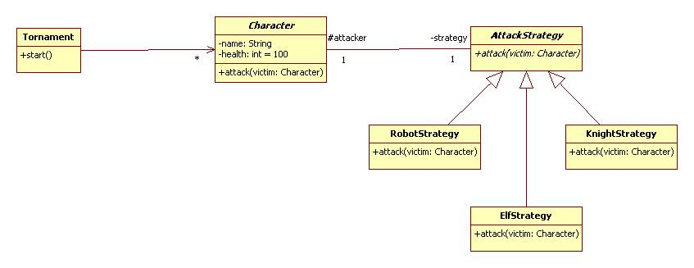
Strategy design pattern
Lets you use different algorithms (strategy) depending on the context
Notes:
http://www.cs.sjsu.edu/~pearce/modules/cases/uw/strategy.htm

Slide 31
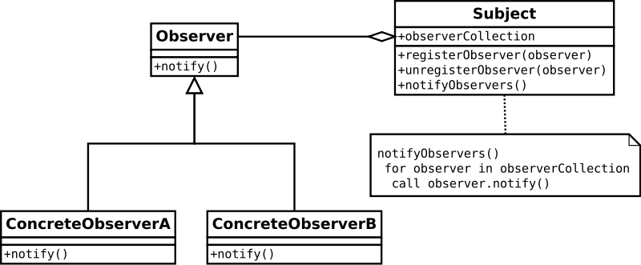
Observer design pattern
Allow objects to notify other objects about events occurring
Notes:
http://en.wikipedia.org/wiki/Observer_pattern

Slide 32
Phases
We can generalize SDLC into 5 different phases:
Initiation
Discovery
Construction
Final Verification and Validation
Closeout

Slide 33
Phases
We can generalize SDLC into 5 different phases:
Initiation
Discovery
Construction
Final Verification and Validation
Closeout

Slide 34
Final Verification and Validation Phase
Construction Phase
Final Verification and Validation Phase
Closeout Phase
Software Design Patterns

Slide 35
Final Verification and Validation Phase
The IT Business Analyst supports final testing before the completed solution is deployed, reviewing test plans and results and ensuring that all requirements are tested

Slide 36
Testing

Slide 37
Testing
Testing is a process of identifying defects
To find problems with the system
Develop test cases and test data
A test case is a formal description of
A starting state
One or more events to which the software must respond
The expected response or ending state
Test data is a set of starting states and events used to test a module, group of modules, or entire system

Slide 38
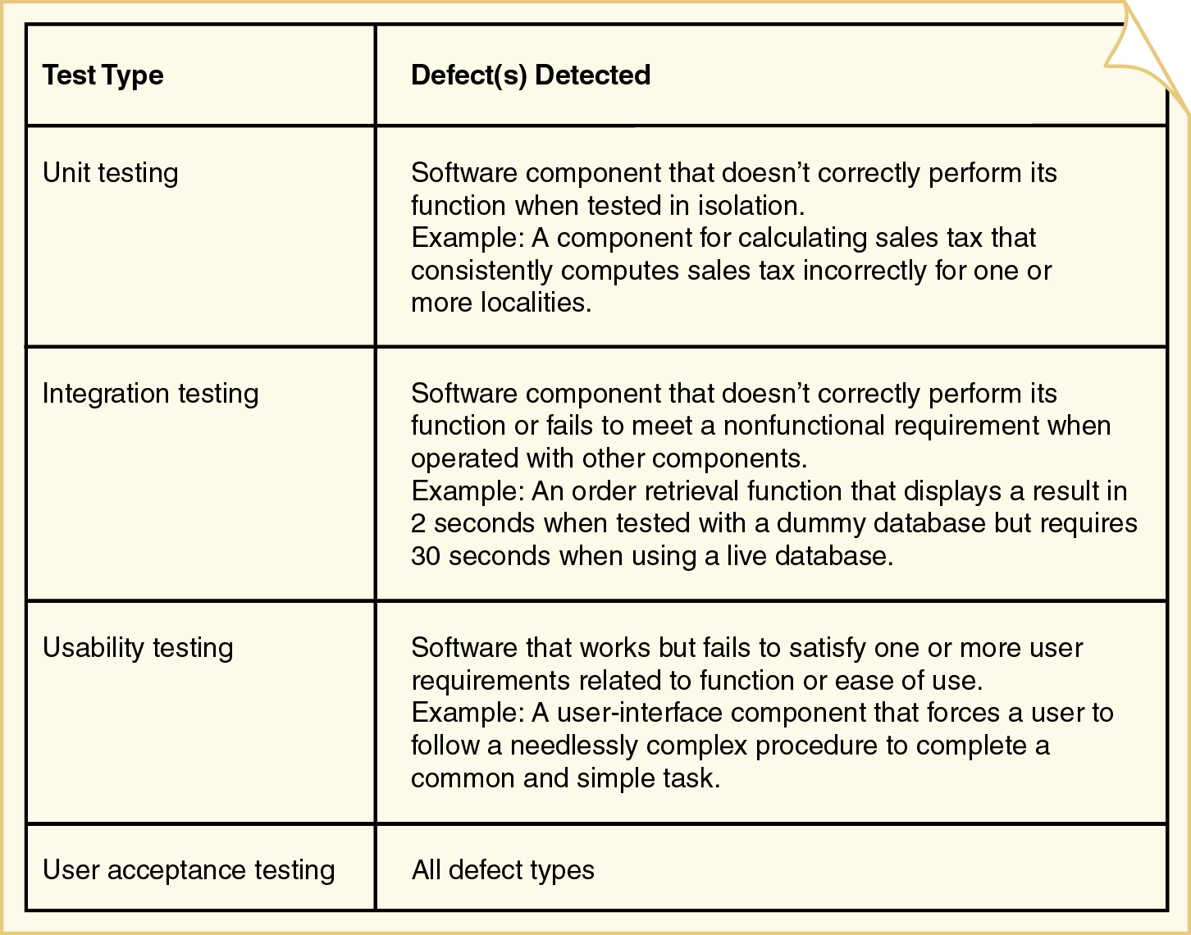
Test types and detected defects

Slide 39
Unit Testing
The process of testing individual methods, classes, or components before they are integrated with other software
Two methods for isolated testing of units
Driver
Simulates the behavior of a method that sends a message to the method being tested
Stub
Simulates the behavior of a method that has not yet been written

Slide 40
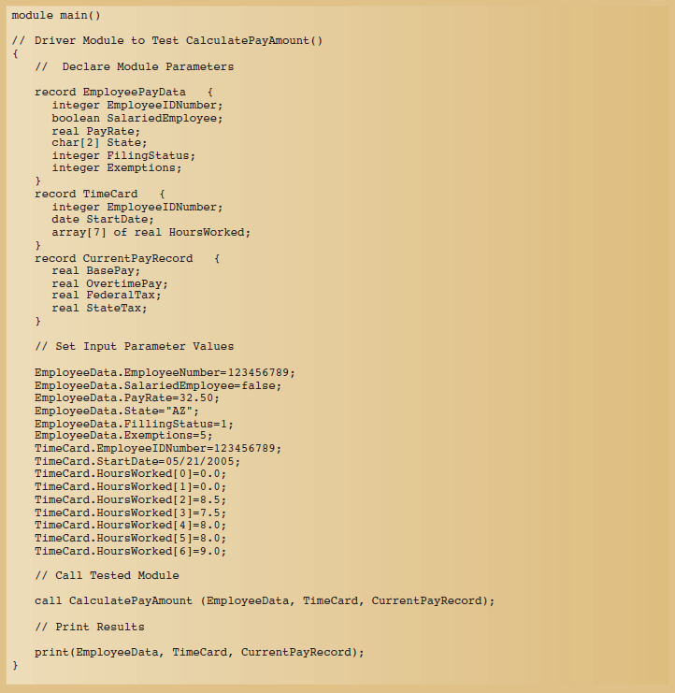
Driver module for testing Calculate pay amount
40

Slide 41
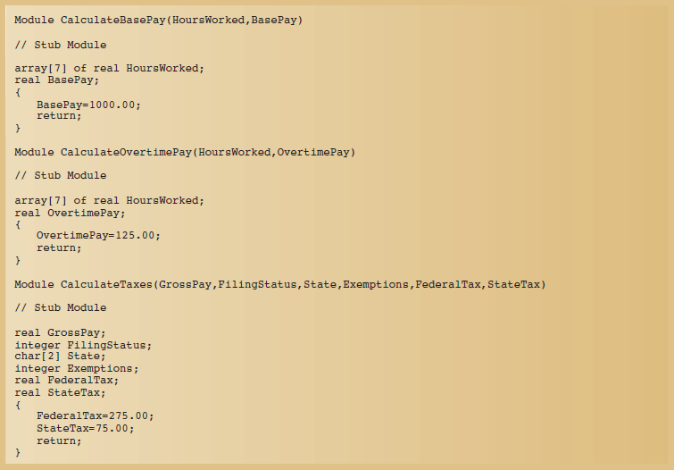
Stub modules for testing Calculate pay amount
Return the expected values without the real implementation

Slide 42
Integration Testing
Evaluates the behavior of a group of methods or classes
Identifies interface compatibility, unexpected parameter values or state interaction, and run-time exceptions
System test
Integration test of the behavior of an entire system or independent subsystem
Build and smoke test
System test performed daily or several times a week
The system is completely compiled and linked (built), and a battery of tests is executed to see whether anything malfunctions in an obvious way (“smokes”)
Build and smoke tests are valuable because they provide rapid feedback on significant problems. Any problem that occurs during a build and smoke test must result from software modified or added since the previous test. Daily testing ensures that errors are found quickly and that they can be easily tracked to their source
Notes:
Build and smoke test is a system test that is typically performed daily or several times per week. The system is completely compiled and linked (built), and a battery of tests is executed to see whether anything malfunctions in an obvious way (“smokes”)
Build and smoke tests are valuable because they provide rapid feedback on significant problems. Any problem that occurs during a build and smoke test must result from software modified or added since the previous test. Daily testing ensures that errors are found quickly and that they can be easily tracked to their source

Slide 43
Usability Testing
Determines whether a method, class, subsystem, or system meets user requirements
Performance test
Determines whether a system or subsystem can meet time-based performance criteria
Response time specifies the desired or maximum allowable time limit for software responses to queries and updates
Throughput specifies the desired or minimum number of queries and transactions that must be processed per minute or hour

Slide 44
User Acceptance Testing
Determines whether the system fulfills user requirements
Involves the end users
Acceptance testing is a very formal activity in most development projects

Slide 45
Testing
Testing activities must be distributed throughout the project
Unit and integration testing occur whenever software is developed, acquired, or combined with other software
Usability testing occurs whenever requirements or design decisions need to be evaluated
User acceptance tests are conducted as a final validation of the requirements, design, and implementation activities

Slide 46
Phases
We can generalize SDLC into 5 different phases:
Initiation
Discovery
Construction
Final Verification and Validation
Closeout

Slide 47
Phases
We can generalize SDLC into 5 different phases:
Initiation
Discovery
Construction
Final Verification and Validation
Closeout

Slide 48
Closeout Phase
Construction Phase
Final Verification and Validation Phase
Closeout Phase
Software Design Patterns

Slide 49
Closeout Phase
The IT Business Analyst supports the deployment process, reviewing transition plans and participating in a post-implementation review to evaluate the success of the change

Slide 50
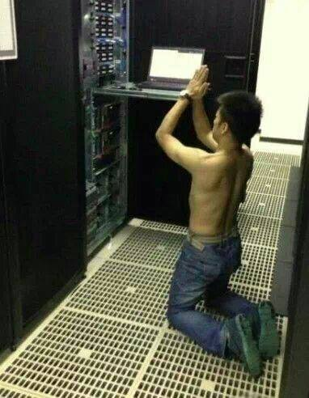
Deployment

Slide 51
Deployment
Activities to make a new system operational
Involve many conflicting constraints
Costs
Need to main positive customer relations
Need to support employees
Logistical complexity
Overall risk to the organization

Slide 52
Deployment
Considerations when planning deployment
Incurring costs of operating both systems in parallel
Detecting and correcting errors in the new system
Potentially disrupting the company and its IS operations
Training personnel and familiarizing customers with new procedures
Each deployment approach has strengths and weaknesses

Slide 53
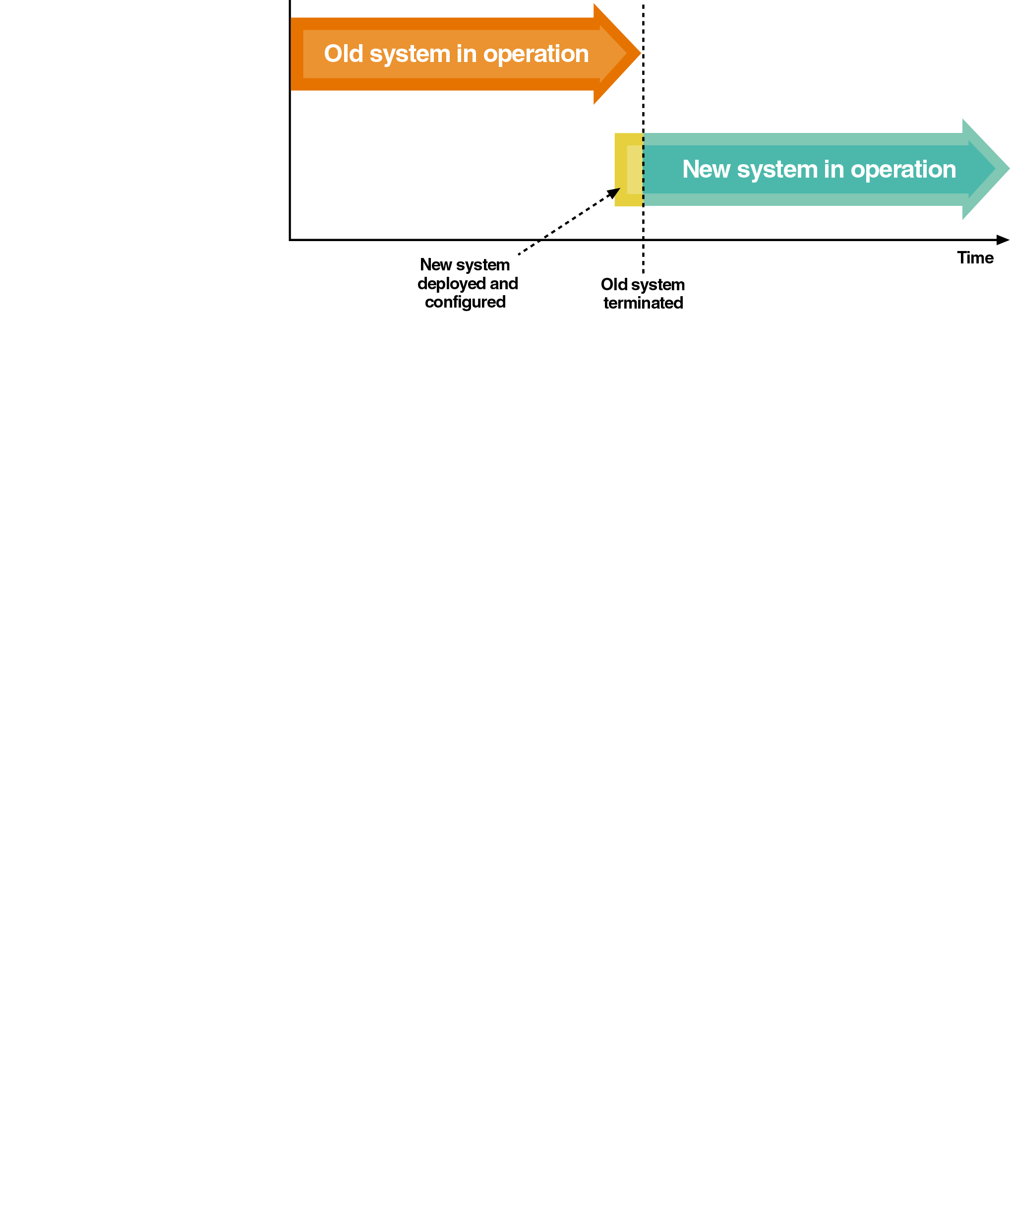
Direct Deployment
Installs a new system, quickly makes it operational, and immediately turns off any overlapping systems
Advantages
Simplicity
Disadvantages
Risk of system unavailability
Used when a new system is not replacing an old system and/or downtime can be tolerated

Slide 54
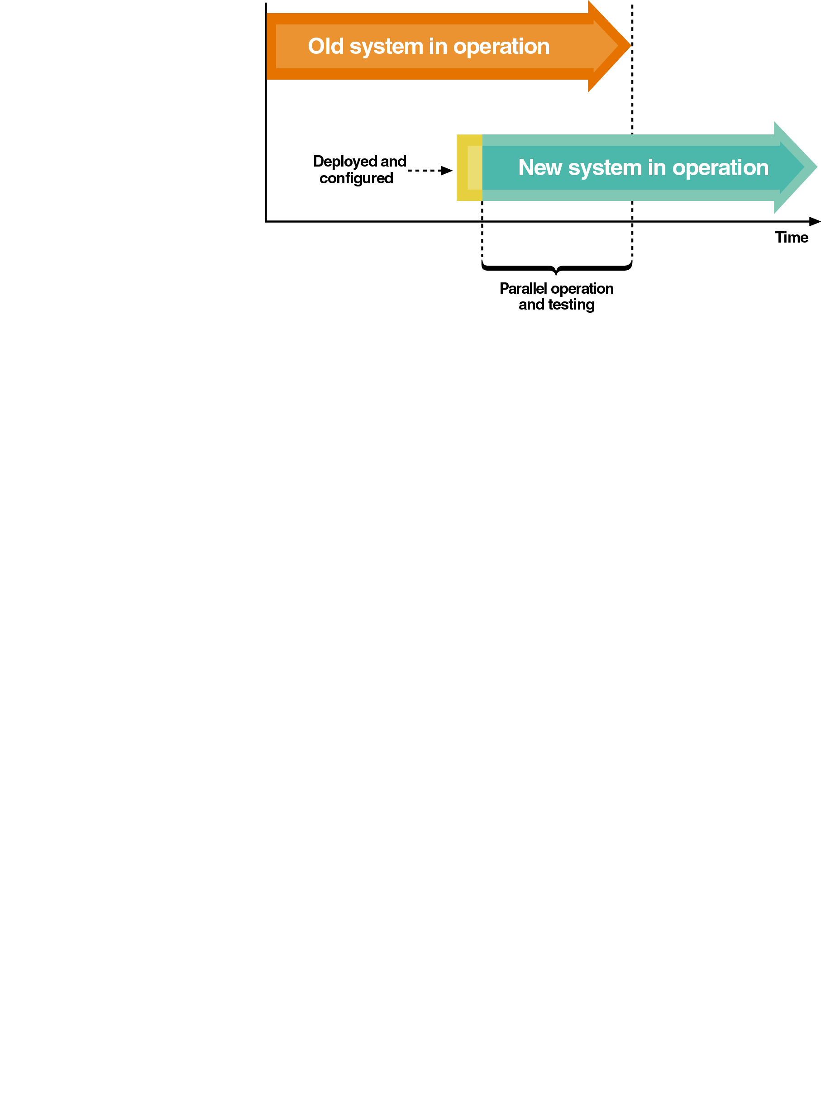
Parallel Deployment
Operates both old and new systems for an extended time period
Advantages
Relatively low risk of system failure
Disadvantage
Cost to operate both systems
Used for mission-critical applications
Partial parallel deployment can be implemented with increased risk of undetected errors

Slide 55
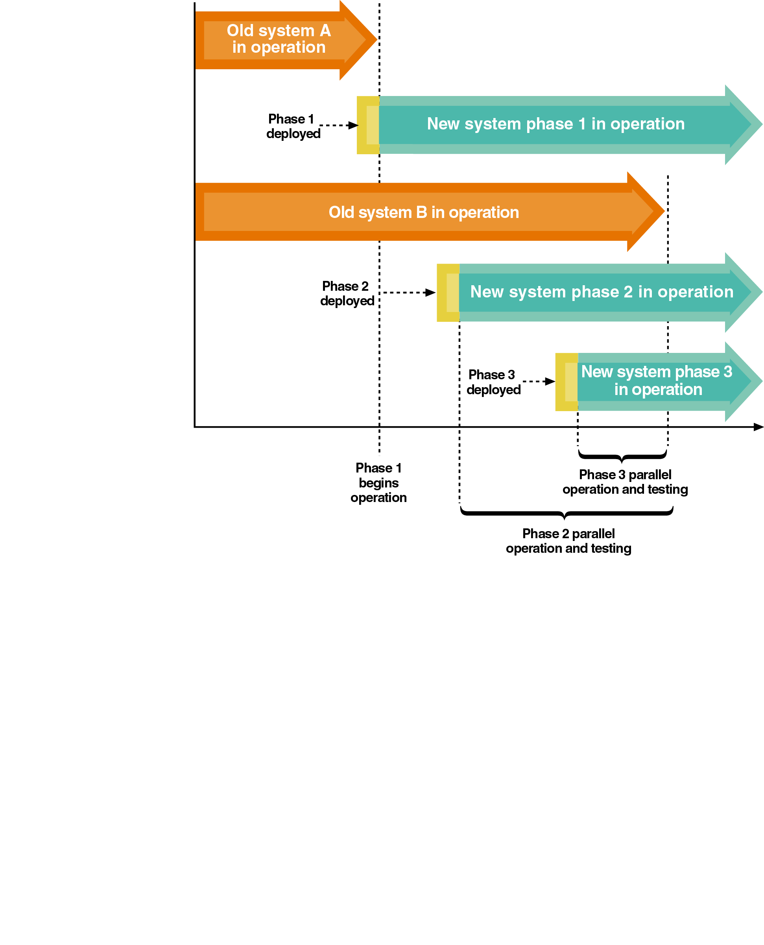
Phased Deployment
Installs a new system and makes it operational in a series of steps or phases
Advantages
Reduced risk
Disadvantages
Increased complexity
Useful when a system is large, complex, and composed of relatively independent subsystems

Slide 56
Acquiring Hardware and System Software
Application software must have a supporting infrastructure (which may already be in place)
Acquisition of an entirely new infrastructure includes
Planning
Developing a request for proposal
Evaluating results
Choosing one or more vendors
Installation and configuration

Slide 57
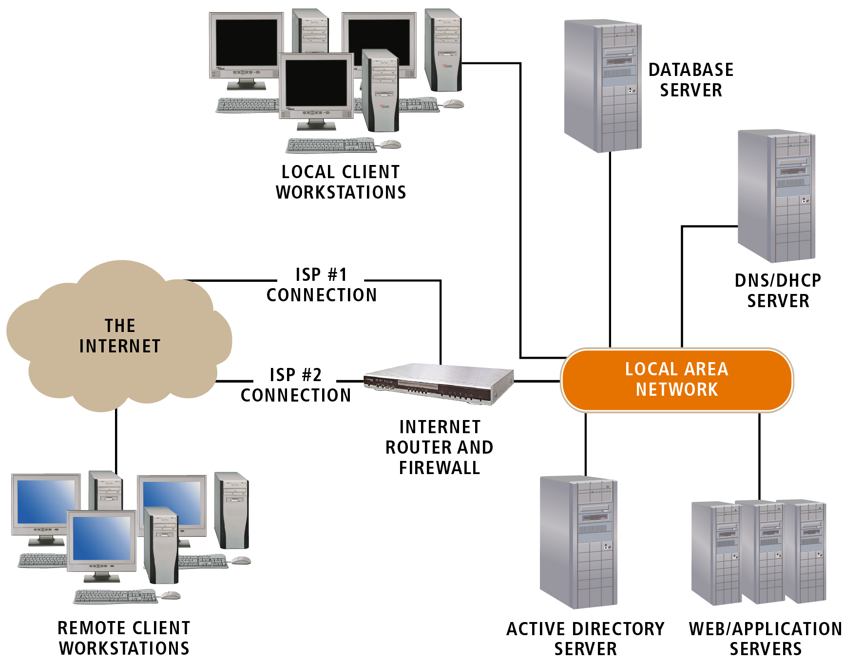
Infrastructure and clients of a typical .NET application

Slide 58
Packaging and Installing Components
Components must be
Installed on a host server
Added to a component registry
Assigned one or more network addresses
May include XML files to store registration and access information
Developers can package and install components using development tools and utilities

Slide 59
Training Users
End users and system operators need training
End user training
Hands-on training and tutorials
Group tutorials
System operator training
Less formal
Self-study
Training materials are developed as soon as the interfaces are reasonably stable

Slide 60
Converting and Initializing Data
Data needed at system startup can be obtained from
Files or databases of a system being replaced
Manual records
Files or databases of other systems in the organizations
User feedback during normal system operation
Existing databases are commonly modified for reuse in new or upgraded systems

Slide 61
Reloading Databases
Complex changes to a database may require reloading the data after the change
Two approaches
Initialize a new database and copy the contents of the old database to it
Use a program or DBMS utility to extract and delete data from an existing database and store it in a temporary data store
Many DBMSs provide import/export utilities to extract and load data

Slide 62
What’s Next?
Course Wrap Up

